Slide 1



Welcome
FCMS Course Selection
6th Grade Counselor –
Dawne Sanders
7th Grade Counselor -
Adrienne Luney

Slide 2
Course Selection
important dates
Window opens:
January 26-February 13
Select courses in SchooLinks
Parent Verification window: March 9-13
In Skyward Q
No schedule changes after: March 13

Slide 3
FCMS Course Selection Info
Housed in Schoology
2. Library Course
3. Counselor's Corner

Slide 4

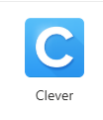
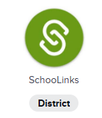
Schoolinks
Course Selection
Go to 1Link
Select Clever
Select SchooLinks

Slide 5
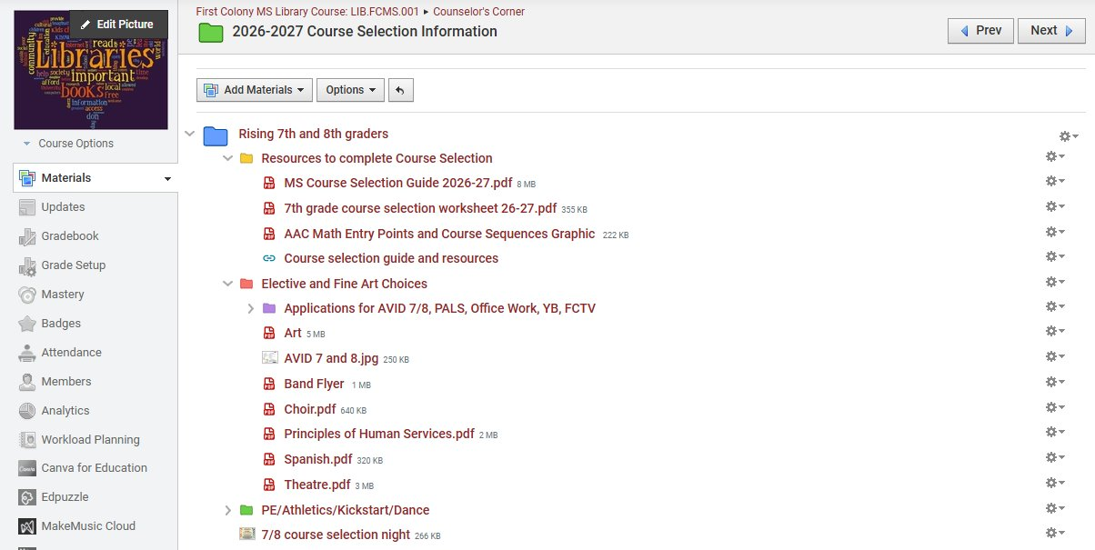
Schoology Resources

Slide 6
High School Courses
Grade earned will appear on High School Transcript
Grade calculated in high school GPA and Class Rank
Level of Responsibility

Slide 7
Course Change Requests
Error
Electives
Level Change from AAC

Slide 8
Error
9 Day Notification Window
Course Verification

Slide 9
Electives
"Electives are a full year and are not changed during the school year."

Slide 10
Level Change from AAC
FBISD District Policy:
Teacher Conference
Grade below 75
A success plan created, attempted and monitored
Attend at least 3 tutorials
Completed all assignments

Slide 11
Rising 7th Grade
Immunizations
MCV4 Meningitis
TDAP
Doctor note/verification turned into our campus Nurse

Slide 12
Course Selection
important dates
Window opens:
January 26-February 13
Select courses in SchooLinks
Parent Verification window: March 9-13
In Skyward Q
No schedule changes after: March 13

